Slide 1
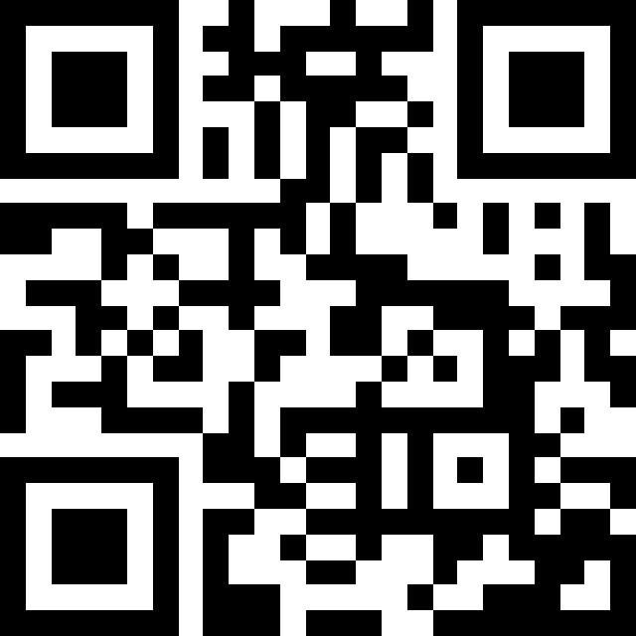
AI Basics and Policy Statements
Teaching and Learning Center, GC
Wed Oct 1, 2025
Facilitated by Zach Muhlbauer https://short-url.org/aipolicy

Slide 2
Agenda
Part I: Demystifying AI (40 min)
Completion game and neural network visualization
AI technology overview
How LLMs work
Part II: Crafting Policies (50 min)
Student testimonials and detection problems
Policy components and values
Draft your syllabus statement

Slide 3
Part I: Demystifying AI Basics

Slide 4
Opening: Completion Game & Free Write
Complete the following sentences:
I ran to…
Please pass the…
I slept through…
Never have I ever…
Intelligence is the ability to..
Post your completions in the chat along with a response to this prompt: What brings you to this workshop, and what do you hope to gain from our time together?
Gemini 2.0 Flash -- Completion Game.pdf

Slide 5
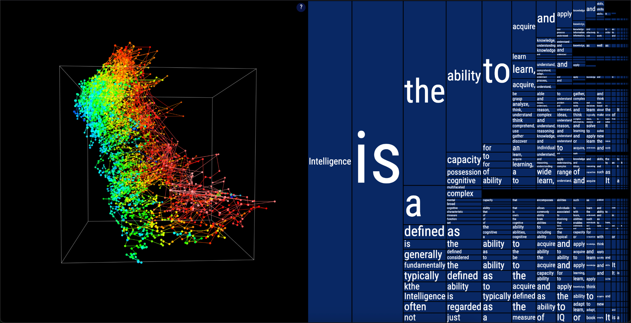
Neural network visualization
Link to visualization: https://moebio.com/mind/

Slide 6
A very brief account of artificial intelligence
Artificial intelligence encompasses many technologies, not just chatbots
Predictive AI attempts to infer events based historical data (credit worthiness)
Computer vision recognizes images and patterns (facial recognition)
Classification systems sort and categorize data (content moderation)
Large language models process and generate human-like text, programming code, and structured data (Gemini, Claude, ChatGPT)
Generative Pretrained Transformers: models using transformer architecture (attention mechanisms that process all words simultaneously) to generate context-aware text

Slide 7
How large language models (LLMs) work
Pattern-matching systems that produce text, code, and/or media
Trained on billions of text samples from books, websites, articles, & software
Registers statistical patterns in how words or code follow each other
Uses patterns to process and generate responses one “token” at a time
Output varies greatly with prompt phrasing, structure, and composition

Slide 8
Part II: Crafting an AI Policy Statement

Slide 9
Pedagogical differences to flag
Students are more liable to use AI irresponsibly when under time constraints
Some LLM services retain conversation history, others don't
Data privacy policies vary significantly
Environmental costs depend on model provider and usage type
Free vs. paid features affect student access
Process-based vs. detection-based approaches…

Slide 10
AI detection & learning from Reddit testimonials
“Even spelling out CUNY on the title page was flagged”
“Its really out of control AI is here to stay and these detectors are not any way accurate. Teachers and professors need to stop accusing ppl of this. It also seems anyone with a heightened vocabulary gets flagged so you have to dumb down your writing skills. Something needs to give here.”
“I stopped caring what these AI detectors say, bc they do not work. I tried to test it one day and wrote something very quick in a really bad writing style that would get an F if graded, and it still told me it’s AI.”

Slide 11
Crafting your policy
Definition scope: Determines which technologies your policy covers
Values emphasis: Defines your pedagogical priorities, connects with learning goals, and describes how you see AI’s role in learning.
Permission levels: Sets terms of engagement for if, when, and how students can use AI tools.
Documentation requirements: Establishes what attribution or evidence students need to provide about their AI use, if at all.​​​​​​​​​
For the purposes of this course, AI refers to [define scope]. This course values [state values]. Therefore, [state permission levels]. Constructive uses include [list examples]. Discouraged uses include [list examples]. Any permitted AI use must be documented with [documentation requirement].​​​​​​​​​​​​​​​​

Slide 12
Reviewing Syllabi Models (15 min)
Lance Eaton has sourced a variety of AI syllabus statements. Take a look and select a syllabus policy that resonates with your teaching approach. Take five minutes to adapt it, focusing on definitions of AI and how the language and permissions align with your pedagogical values.
Syllabi Policies for AI Generative Tools
For the purposes of this course, AI refers to [define scope].
This course values [state values].
Therefore, [state permission levels].

Slide 13
Final Steps & Share Out
Let’s spend the rest of our time together drafting your work-in-progress policy, drawing on the following resource for explicit language on use cases, documentation strategies, and other policy components:
Worksheet for Creating your AI course policy
Constructive uses include [list examples].
Discouraged uses include [list examples].
Any permitted AI use must be documented with [documentation requirement].​​​​​​​​​​​​​​​​
When you’re ready, share the draft in the chat and respond to one of your peers.

Slide 14
Resources, Links, and Q&A
Institutional AI Policies & Governance Structures for Higher Education
Syllabi Policies for AI Generative Tools
Worksheet for Creating your AI course policy
Creating an AI Course Policy Workshop Kit | Teaching Commons
Teach@CUNY AI Toolkit
Critical AI Literacy Institute (CALI)
CALI Zotero Library on Generative AI
Interactive Neural Network Visualization
Attend the GC’s Open AI Working Group on October 8: https://cuny.is/gc-ai
Check out the TLC’s AI programming and consider applying for my focused-inquiry group: https://tlc.commons.gc.cuny.edu/2025/09/18/tlc-workshops-and-events-fall-2025/

